Slide 1
Elements of Econometrics. Lecture 1. Introduction.
FCS, 2022-2023

Slide 2
The Subject of Econometrics
Econometrics is the application of statistical methods to the quantification and critical assessment of hypothetical economic relationships using data.
The Art of Econometrician: Finding the set of assumptions which are sufficiently specific and realistic in order to take the best possible advantage from the data available. (E.Malinvaud).

Slide 3
The Aims and Approaches of the Course
The aims of the course are:
- To develop an understanding of the use of regression analysis for quantifying economic relationships and testing economic theories.
- To equip for reading and evaluation of empirical papers in professional journals.
To provide practical experience of using econometric software to fit economic models (Econometric Views, R, Stata, Gretl, or other software are possible).

Slide 4
Methodology of Econometrics:
1. Statement of Theory or Hypothesis
2.Specification of Mathematical Model
3. Specification of Econometric Model
4. Obtaining the Data
5. Estimation of the Parameters
6. Hypothesis Testing
7. Forecasting or Prediction
8. Using the Model for Control or Policy Purposes

Slide 5
Economic Relationships and Models Considered in the Course
Demand and Supply functions;
Earnings functions;
Production functions;
Economic growth models;
Educational attainment functions;
Consumption functions;
Investment functions;
Macroeconomic equilibrium models;
Exchange Rate Models;
Academic success models.

Slide 6
The Nature of Economic Data: Cross Section, Time Series and Panel Data
Cross-sectional data sets
May include samples of individuals, households, firms, cities, states, countries, or other units at a given point of time or in a given period.
Cross-sectional observations are more or less independent.
An example is pure random sampling from a population.
Sampling may be characterized by clustering.
Cross-sectional data is typically considered in applied microeconomics.
Time Series data sets
include observations of variables over time.
Examples are exchange rates, stock prices, CPI, GDP, automobile sales, etc.
Time series observations are typically serially correlated.
Ordering of observations is important.
Data frequency may include daily, weekly, monthly, quarterly, annually, etc.
Typical features of time series include trends and seasonality.
Typical applications include applied macroeconomics and finance.

Slide 7
The Nature of Economic Data: Cross Section, Time Series and Panel Data
Panel (longitudinal) data sets
The same cross-sectional units are followed over time.
Panel data have a cross-sectional and a time series dimension.
Panel data can be used to account for unobserved heterogeneity, or time-invariant unobservables.
Examples are regular surveys of the set of households, individuals; economic growth annual data for a set of countries; quarterly financial indicators of a set of firms, etc.

Slide 8

Cross Section Data Example: ICEF Students’ Performance in Econometrics, 2021-2022: ICEF and UoL Final Exams Grades related to the March ICEF Grades
March ICEF Grades
Scatter plots of the ICEF Final exam and the University of London exam grades in Elements of Econometrics related to the ICEF March exam grades. Correlations are 83% and 42% respectively.
Are there relationships? Are they linear? How to interpret the parameters? Are any factors missing? Can they be used for prediction in 2023?

Slide 9
Time Series Data Example: Price of Oil (Brent) and RuR/USD Exchange Rate (2020-2022)
The relationship is available but there are questions to answer:
What is the causality, which variable is explanatory and which one is dependent?
Are there other factors to be included in the model? What about the role of COVID-19 Pandemic, sanctions, CBR policies?
What was the time structure of the relationship (lags, trends, autocorrelations, etc)?
Was the reaction the same or changing in time?
Could be the Exchange Rate behavior in 2022 predicted basing on this data?

Slide 10
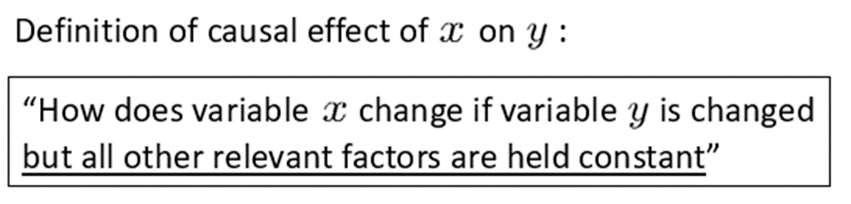
The Nature of Economic Data: Causality and the notion of ceteris paribus
Ceteris paribus: “other relevant factors being equal.”
Most economic questions are ceteris paribus questions.
It is important to define which causal effect one is interested in.
It is useful to describe how an experiment would have to be designed to infer the causal effect in question.
Examples: use of fertilizer and crops, hours of study and grades, education and earnings, price of oil and exchange rates, etc.
The concept of endogeneity: bilateral influence.

Slide 11
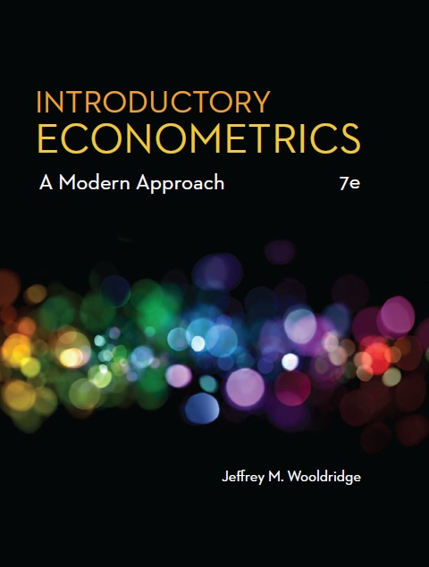
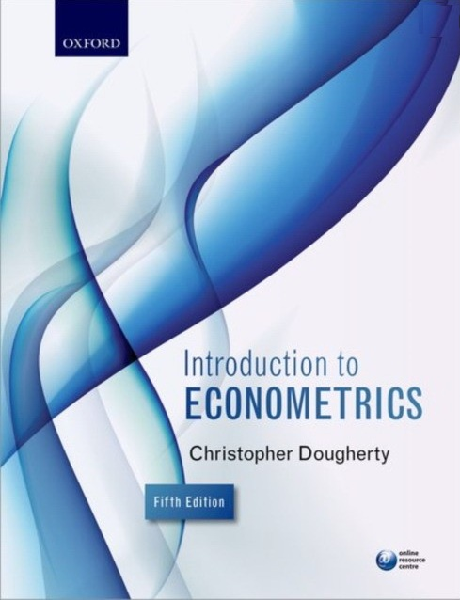
Main textbooks

Slide 12
Reading
Main Textbooks:
Wooldridge J.M. Introductory Econometrics. A modern approach 7th (or any earlier) edition. Cengage, 2020
Dougherty, Christopher. Introduction to Econometrics. Oxford University Press, 2011, 2016 (4th or 5th edition).
Student resources for the books (Data sets, slides, Study Guide): VLE, OUP
Additional Textbooks:
Gujarati D.N. Basic Econometrics.
Study Guides:
EC2020 Elements of Econometrics. UoL Study Guide, 2022. Schafgans, M. and Komarova, T. (VLE)
ICEF materials: Lecture Notes, Slides, Video lectures, Class Notes, Exam Materials (ICEF Information System).

Slide 13
Main Electronic Resources:
github
VLE Student Portal: http://my.london.ac.uk/
Course EC2020 Elements of econometrics
Oxford University Press:
http://global.oup.com/uk/orc/busecon/economics/dougherty5e/
Eviews Website:
https://www.eviews.com/home.html
For downloading the Eviews 12 Student Lite free version indicate that you are the University of London student, UK, and use the UoL student Email.

Slide 14


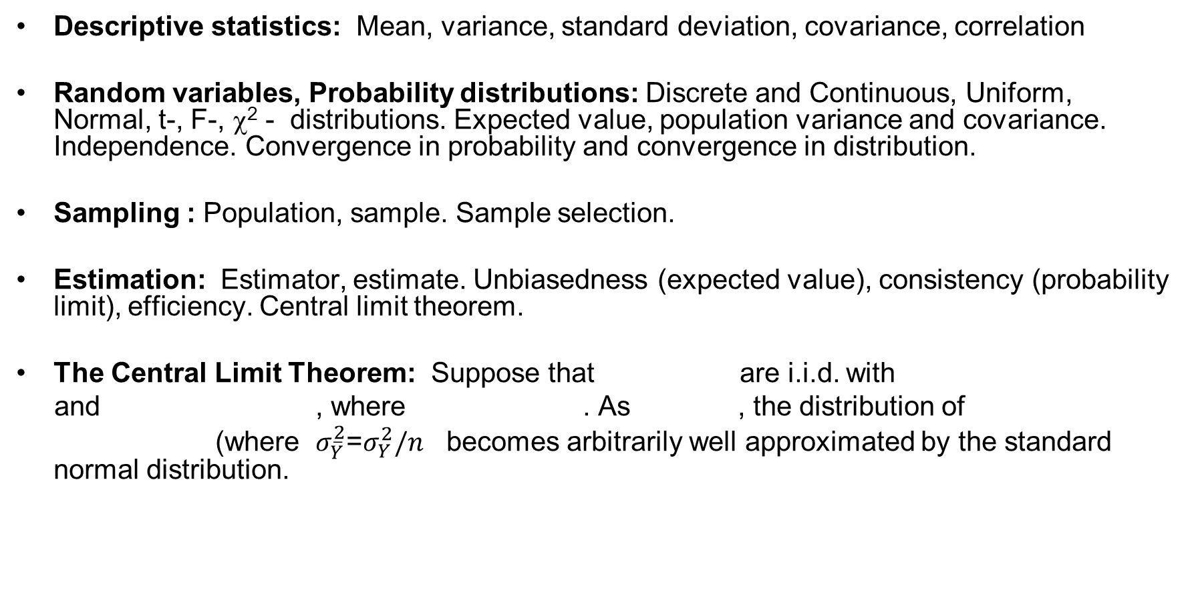




Statistical Glossary for Econometrics:
Descriptive statistics: Mean, variance, standard deviation, covariance, correlation
Random variables, Probability distributions: Discrete and Continuous, Uniform, Normal, t-, F-, χ² - distributions. Expected value, population variance and covariance. Independence. Convergence in probability and convergence in distribution.
Sampling : Population, sample. Sample selection.
Estimation: Estimator, estimate. Unbiasedness (expected value), consistency (probability limit), efficiency. Central limit theorem.
The Central Limit Theorem: Suppose that are i.i.d. with
and , where . As , the distribution of
(where $σ_{\overline{Y}}^{2}$=$σ_{Y}^{2}/n$ becomes arbitrarily well approximated by the standard normal distribution.
$Y_{1},…,$ $Y_{n}$
$$E\left(Y_{i}\right)=µ_{Y}$$
${{Var\left(Y_{i}\right)=\hat{σ}}_{Y}}^{2}$
${{0<\hat{σ}}_{Y}}^{2}<∞$
$n→∞$
$$(\overline{Y}−µ_{Y})/σ_{\overline{Y}}$$

Slide 15
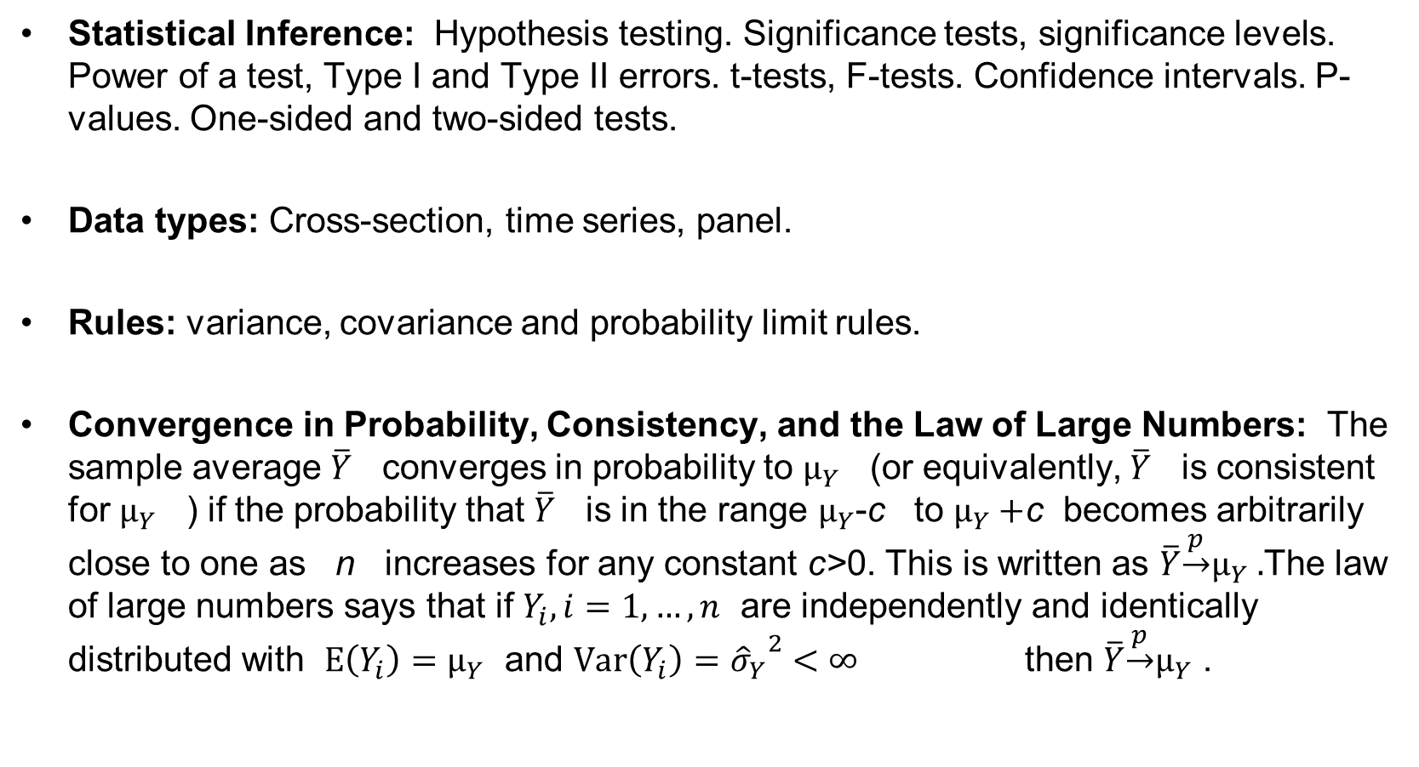
Statistical Glossary for Econometrics:
Statistical Inference: Hypothesis testing. Significance tests, significance levels. Power of a test, Type I and Type II errors. t-tests, F-tests. Confidence intervals. P-values. One-sided and two-sided tests.
Data types: Cross-section, time series, panel.
Rules: variance, covariance and probability limit rules.
Convergence in Probability, Consistency, and the Law of Large Numbers: The sample average $\overline{Y}$ converges in probability to $µ_{Y}$ (or equivalently, $\overline{Y}$ is consistent for $µ_{Y}$ ) if the probability that $\overline{Y}$ is in the range $µ_{Y}$-c to $µ_{Y}+$c becomes arbitrarily close to one as n increases for any constant c>0. This is written as $\overline{Y}\underset{→}{p}µ_{Y} .$The law of large numbers says that if $Y_{i},i=1,…,n$ are independently and identically distributed with $E\left(Y_{i}\right)=µ_{Y}$ and ${{Var\left(Y_{i}\right)=\hat{σ}}_{Y}}^{2}$ $<∞$ then $\overline{Y}\underset{→}{p}µ_{Y}$ .

Slide 16
Example: Convergence in Probability, or Plim rules
Plim rule 1 plim (X + Y) = plim X + plim Y
Plim rule 2 plim bX = b plim X
Plim rule 3 if b is a constant, plim b = b
Plim rule 4 plim Z = (plim X)(plim Y)
Plim rule 5
Plim rule 6 plim f(X) = f(plim X)
plim X
plim Z =
plim Y

Slide 17


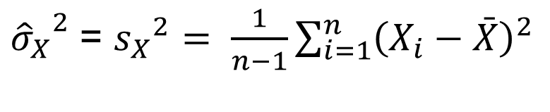


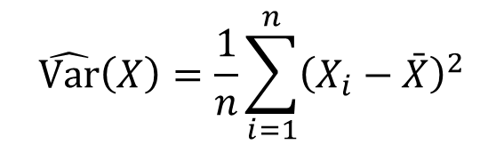
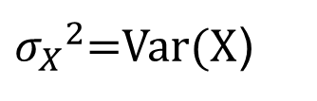

Notation in the course (examples)
Greek letters – true values, Greek with hats or Latin - estimators
– population variance of X
- unbiased estimator of
population variance.
For the regression model we denote b₁ and b₂ as any (unknown) estimators of and , while and
are their OLS estimators.
${σ_{X}}^{2}$=Var(X)
$$\hat{Var}\left(X\right)=\frac{1}{n}\sum_{i=1}^{n}{{\left(X_{i}−\bar{X}\right)}^{2}}$$
- sample variance
${{\hat{σ}}_{X}}^{2}$= ${s_{X}}^{2}= \frac{1}{n−1}\sum_{i=1}^{n}{{\left(X_{i}−\bar{X}\right)}^{2}}$
$$Y=β_{1}+β_{2}X+u$$
$$β_{1}$$
$$β_{2}$$
$${\hat{β}}_{1}$$
$${\hat{β}}_{2}$$

Slide 18
Some issues which are important in applied analysis
Correct specification (functional form, regressors availability)
Endogeneity
Sample selection
Sample size
Multicollinearity
Nonstationary Time Series
Unobserved Heterogeneity

Slide 19


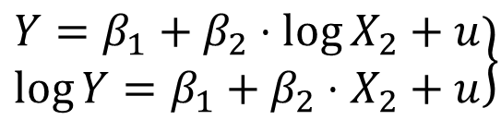

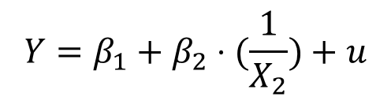
Types of Relationships in the Course
Linear relationships
Non-linear relationships
Semi-logarithmic relationships
Double-logarithmic relationship
Polynomial relationship
Inverse Relationship
$$Y=β_{1}+β_{2}⋅X_{2}+...+β_{m}⋅X_{m}+u$$
$$Y=f(X)+u$$
$$\left.\begin{aligned}Y=β_{1}+β_{2}⋅\log{X_{2}}+u \\ \log{Y}=β_{1}+β_{2}⋅X_{2}+u\end{aligned}\right\}$$
$$\log{Y}=β_{1}+β_{2}⋅\log{X_{2}}+u$$
$$Y=β_{1}+β_{2}⋅X_{2}^{k_{2}}+...+β_{m}⋅X_{m}^{k_{m}}+u$$
$$Y=β_{1}+β_{2}⋅(\frac{1}{X_{2}})+u$$

